Slide 1
Lesson-2 Creating First App

Slide 2
Agenda
Introduction to Android Studio
Creation of HelloWorld app
Android Project Structure and Folders
Styles and Themes

Slide 3
Introduction to Android Studio
Android Studio is the new foundation of Google’s efforts to give Android developers top-notch development tools.
Android Studio is a special version of IntelliJ IDEA(leading Java IDE) that interfaces with the Android Software Development Kit (SDK) and the gradle build system.
Gradle is the native build system for Android Studio. Hence, if you are using that IDE, you should get a build.gradle file automatically. Will discuss about this in later chapters.

Slide 4
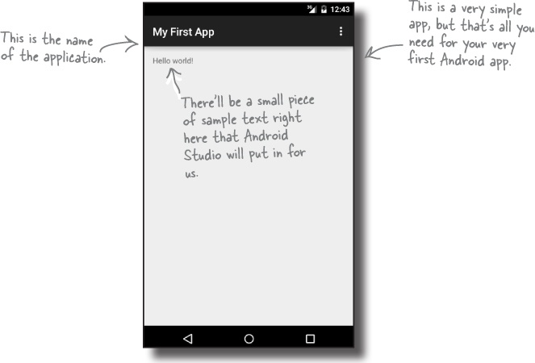
Initial HelloWorld App Example
Now that you’ve set up your development environment, you’re ready to create your first Android app. Here’s what the app will look like:

Slide 5
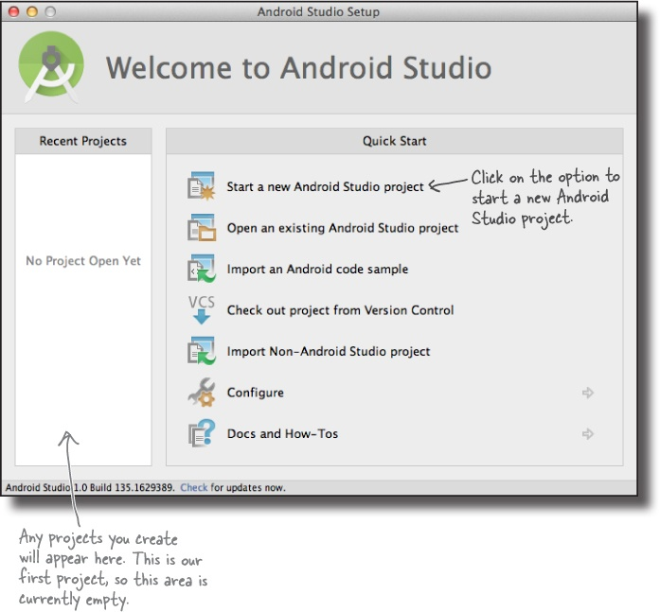
1. Create a new project
The Android Studio welcome screen gives you a number of options for what you want to do. We want to create a new project, so click on the option for “Start a new Android Studio project”. (or) File -> New->New Project

Slide 6
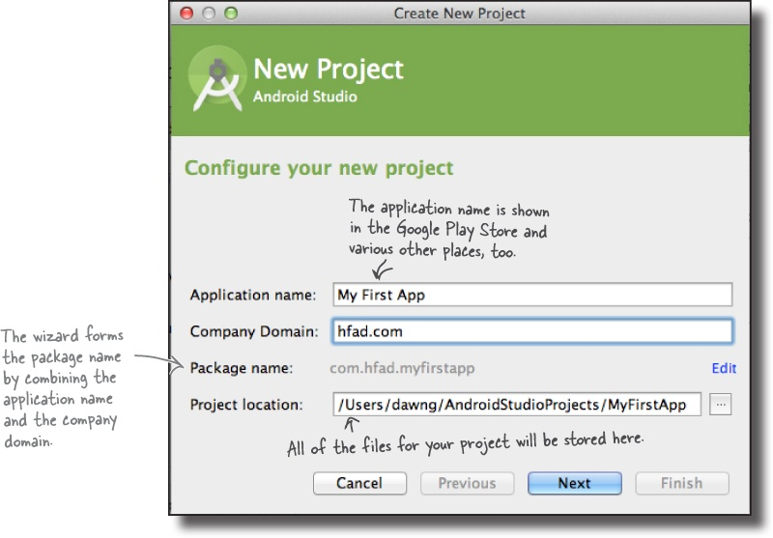
Create a new project

Slide 7
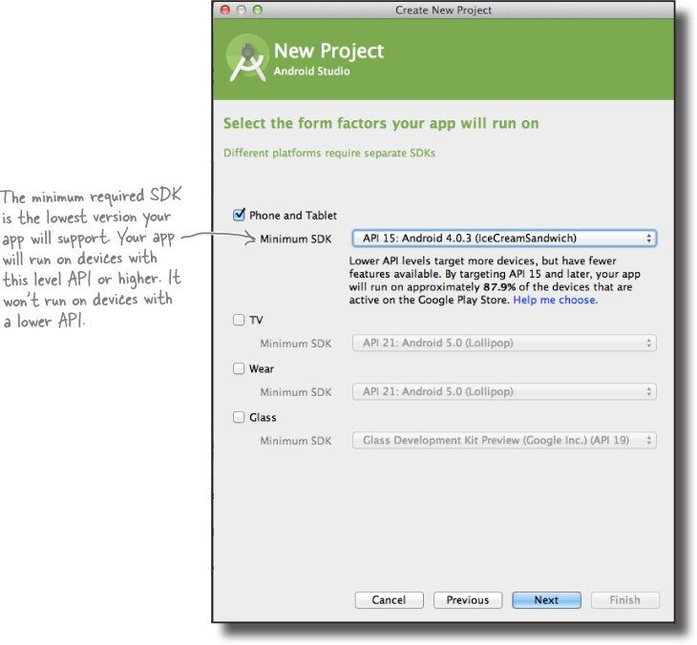
Notes:
Android: Minimum supported version is now Android 4.1 Jelly Bean

Slide 8
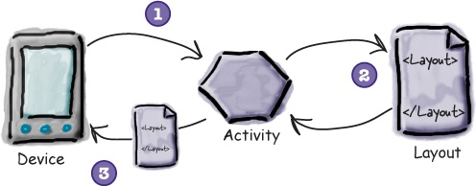
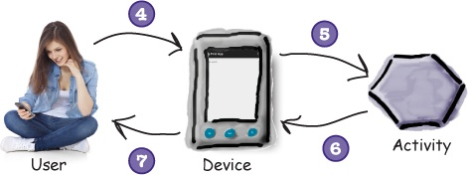
After click next
The next thing you’ll be prompted to do is add an activity to your project. Every Android app is a collection of screens, and each screen is comprised of an activity and a layout.
An activity is a single, defined thing that your user can do. You might have an activity to compose an email, take a photo, or find a contact. Activities are usually associated with one screen, and they’re written in Java.
A layout describes the appearance of the screen. Layouts are written as XML files and they tell Android how the different screen elements are arranged.
Notes:
Layouts define how the user interface is presented.
Activities define actions.
The device launches your app and creates an activity object.
The activity object specifies a layout.
The activity tells Android to display the layout on screen.
The user interacts with the layout that’s displayed on the device.
The activity responds to these interactions by running application code.
The activity updates the display...
...which the user sees on the device.

Slide 9
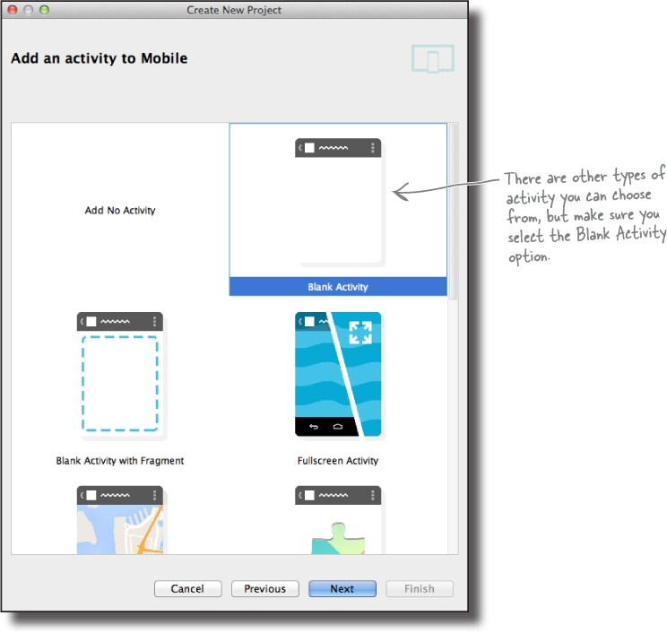

Slide 10
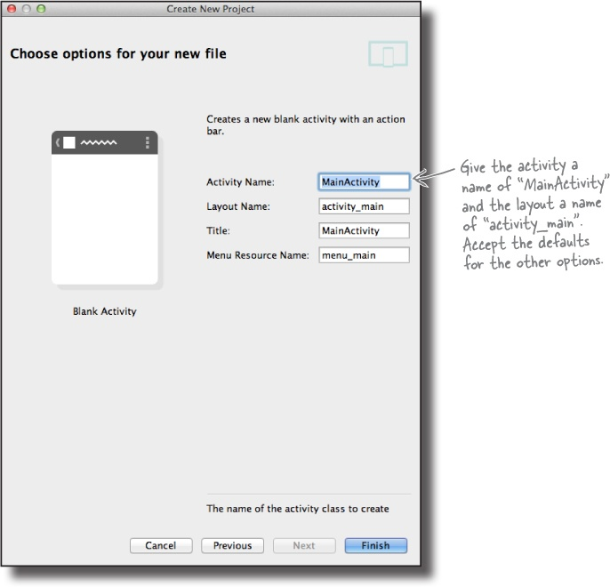
When you click on the Finish button, Android Studio will build your app.

Slide 11
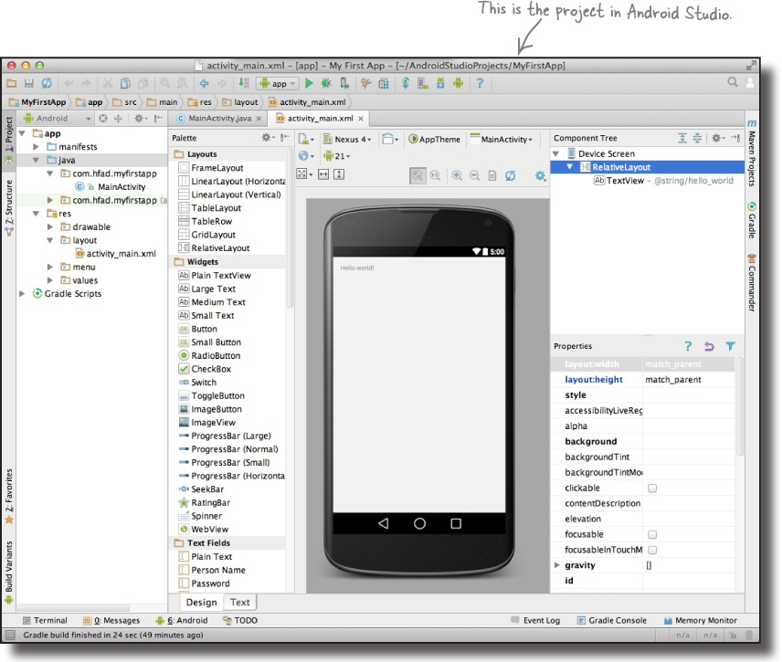
Creation of HelloWorldApp
Here’s what our project looks like (don’t worry if it looks complicated right now, we’ll break it down over the next few slides):

Slide 12
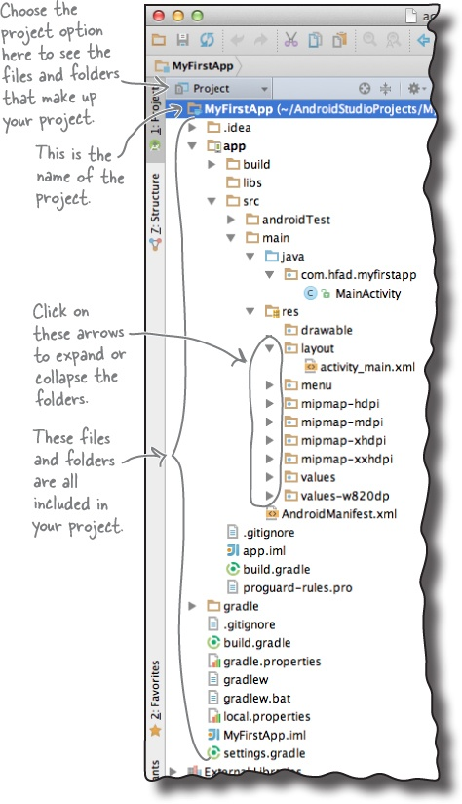
The folder structure
The explorer contains all of the projects that you currently have open.
Notes:
Java and XML source files
These are the activity and layout files the wizard created for you.
Android-generated Java files(R.java – R – Stands for Resources)
There are some extra Java files you don’t need to touch which Android Studio generates for you automatically.
R.java is an abstraction between resource files and Java files
For every resource R.java creates a static id integer field
Resource files
These include default image files for icons, styles your app might use, and any common String values your app might want to look up.
Android libraries
In the wizard, you specified the minimum SDK version you want your app to be compatible with. Android Studio makes sure it includes the relevant Android libraries for this version.
Configuration files
The configuration files tell Android what’s actually in the app and how it should run.

Slide 13
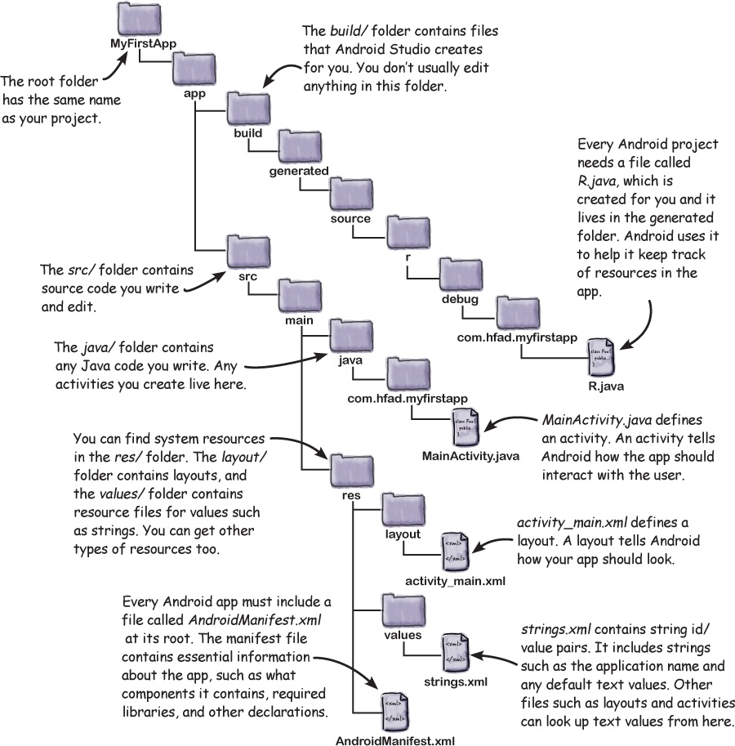
Useful files in your project

Slide 14
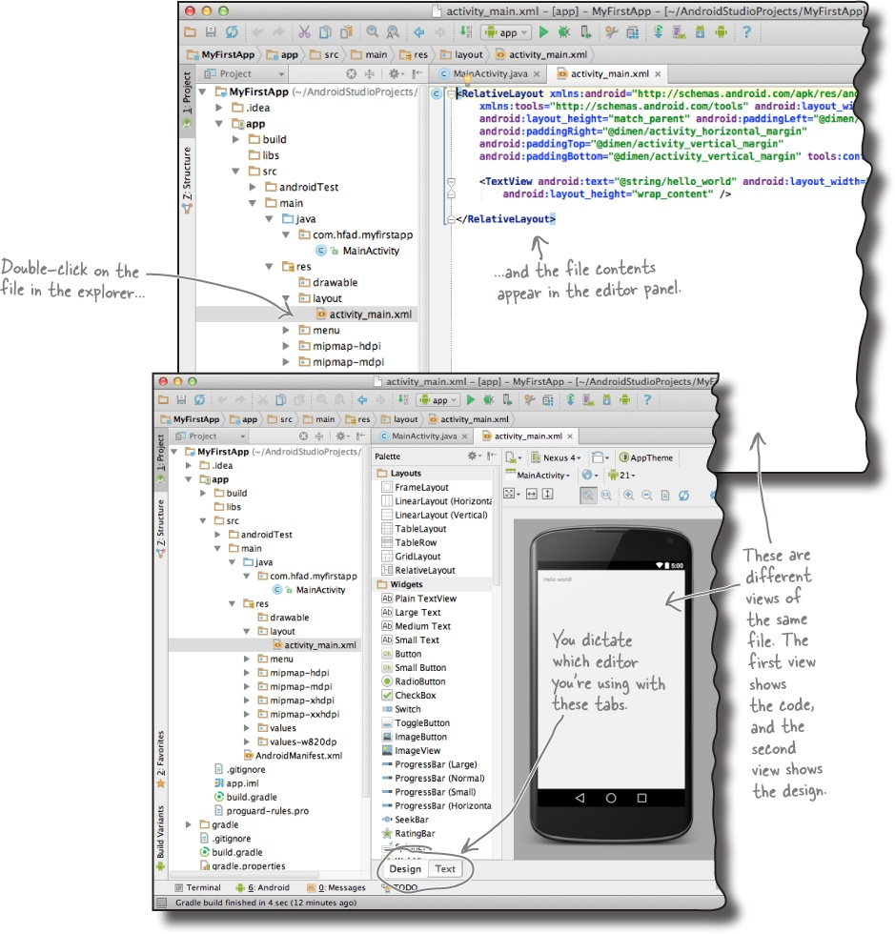
Code and Design Editor
Notes:
Code Editor : Most files get displayed in the code editor. The code editor is just like a text editor, but with extra features such as color coding and code checking.
Design Editor : If you’re editing a layout, you have an extra option. Rather than edit the XML, you can use the design editor. The design editor allows you to drag GUI components onto your layout, and arrange them how you want. The code editor and design editor give different views of the same file, so you can switch back and forth between the two.

Slide 15
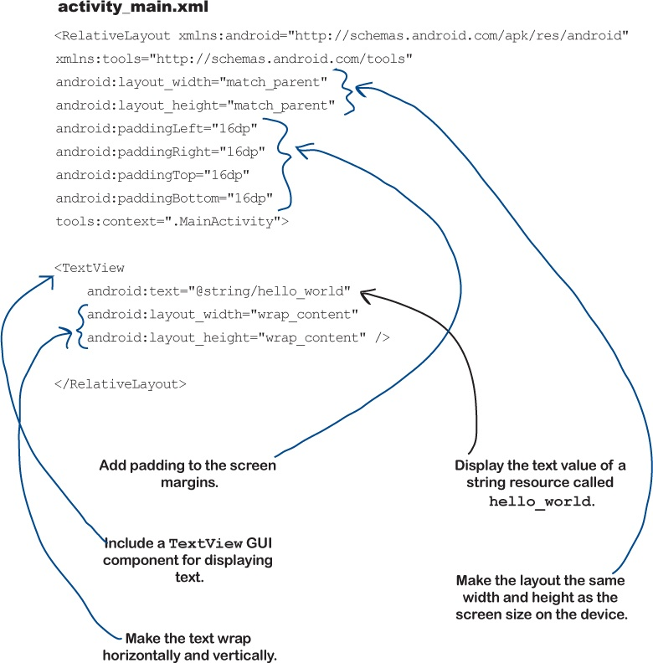
activity_main.xml
Notes:
Activity_main.xml is a layout file.
XML is used to transfer data between multiple technologies.
The first line with url says that every xml file need to follow the XSD(XML Schema Definition)
Layout helps to organize the UI components.
Every UI component need to specify width and height
To Specify Width and Height use five parameters
fill_parent - occupy the complete screen ( Deprecated Method API level 8)
match_parent - occupy the complete screen
Wrap_content - occupy the screen up to the content
Pixels –Specify in pixels
dps – It is the best choice it adjust according to the screen resolution
References
Taken in part or whole from http://developer.android.com/guide/components/activities.html

Slide 16
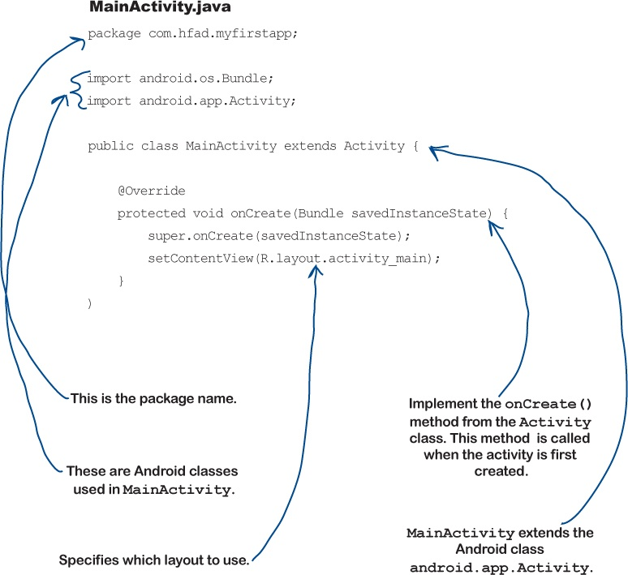
MainActivity.java
Notes:
An activity is a single screen in an application with some UI components. It is a Java File.
To create an Activity follow these steps
Create a class which extends Activity ( which import from andriod.app.Activity )
Usually in Java execution starts with main method() but in Android execution starts with onCreate(), so provide implementation for onCreate() method
By using setContentView() specify the XML file R.layout.activity_main.
References
Taken in part or whole from http://developer.android.com/guide/components/activities.html
By default if you create a new project MainActivity extends AppCompatActivity
AppCompatActivity is a class from v7 appcompat library. This is a compatibility library that back ports some features of recent versions of Android to older devices.

Slide 17
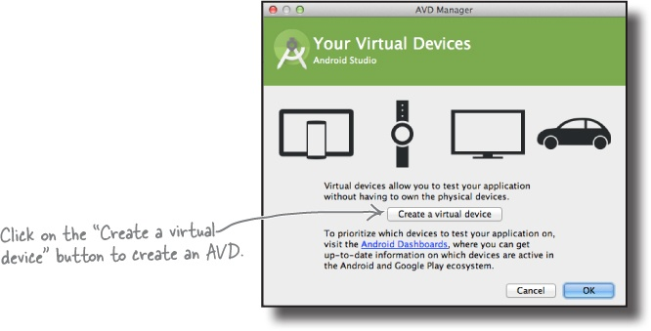
Open the Android Virtual Device Manager
The AVD Manager allows you to set up new AVDs, and view and edit ones you’ve already created.
Open it by selecting Android on the Tools menu and choosing AVD Manager.
Click on the “Create a virtual device” button.
Notes:
An Android Virtual Device (AVD) is a device configuration that is run with the Android emulator. It works with the emulator to provide a virtual device-specific environment in which to install and run Android apps.

Slide 18
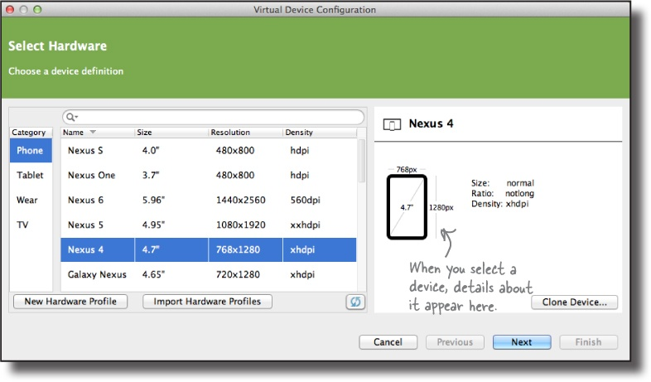
On the next screen, you’ll be prompted to choose a device definition. This is the type of device your AVD will emulate. You can choose a variety of phone, tablet, wear, or TV devices.
For more info : https://developer.android.com/studio/run/managing-avds.html
Notes:
If HAXM is not installed, Intel HAXM can be installed through the Android* SDK Manager by clicking Install HAXM.
HAXM stands for Hardware Accelerated Execution Manager.

Slide 19
Running your App
You can now run the app on a real device or on an emulator.
Run on a Real Device, Set up your device as follows:
Connect your device to your development machine with a USB cable. If you're developing on Windows, you might need to install the appropriate USB driver for your device. For help installing drivers, see the https://developer.android.com/training/basics/firstapp/running-app.html#RealDevice
Enable USB debugging on your device by going to Settings > Developer options. Note: On Android 4.2 and newer, Developer options is hidden by default. To make it available, go to Settings > About phone and tap Build number seven times. Return to the previous screen to find Developer options.
More info available in lesson-4
Run the app from Android Studio as follows:
In Android Studio, select your project and click Run from the toolbar.
In the Select Deployment Target window, select your device, and click OK.
Android Studio installs the app on your connected device and starts it.

Slide 20
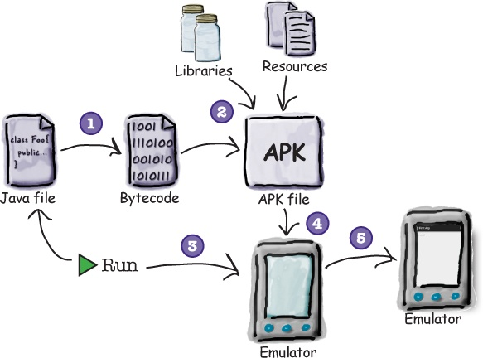
Compile, package, deploy and run
Choosing the Run option doesn’t just run your app. It also deals with all the preliminary tasks that are needed for the app to run:
An APK file is an Android application package. It’s basically a JAR or ZIP file for Android applications.
Notes:
The Java source files get compiled to byte code.
An Android Application Package, or APK file, gets created. (Which is the installation file is Android for the OS)
The file includes the compiled Java files, along with any libraries and resources needed by your app.
Assuming there’s not one already running, the emulator gets launched with the AVD.
Once the emulator has been launched and the AVD is active, the APK file is uploaded to the AVD and installed.
The AVD starts the main activity associated with the app.
Your app gets displayed on the AVD screen, and it’s all ready for you to test out.

Slide 21
Styles and Themes
A style is a collection of attributes that specify the look and format for a View or window.
A style can specify attributes such as height, padding, font color, font size, background color, and much more.
For example, by using a style, you can take this layout XML:
<TextView android:id="@+id/textView" android:layout_width="wrap_content" android:layout_height="wrap_content" android:text="Welcome to Android Course" android:textColor="#FF345F" android:gravity="center" <!– gravity – alignment --> android:textSize="24sp" android:typeface="monospace" android:background="@color/colorPrimaryDark"/>

Slide 22
Defining Styles in Resources
To create a set of styles, save an XML file in the res/values/ directory of your project.
The name of the XML file must use the .xml extension, and like other resources, it must use lowercase, underscores, and be saved in the res/values/ folder.
The root node of the XML file must be <resources>.
For each style you want to create, complete the following series of steps:
Add a <style> element to the file, with a name that uniquely identifies the style.
For each attribute of that style, add an <item> element, with a name that declares the style attribute. The order of these elements doesn't matter.
Add an appropriate value to each <item> element.

Slide 23
Example of Styles.xml
<resources> <!-- Base application theme. --> <style name="AppTheme" parent="Theme.AppCompat.Light"> <!-- Customize your theme here. --> <item name="colorPrimary">@color/colorPrimary</item> <item name="colorPrimaryDark">@color/colorPrimaryDark</item> <item name="colorAccent">@color/colorAccent</item> </style> </resources>
To Change the Theme of your Layout
<style name="AppTheme" parent="Theme.Material">

Slide 24
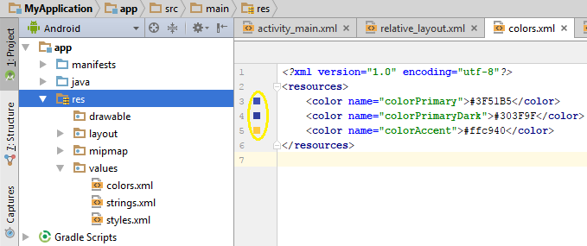
colors.xml
Android uses standard RGB (red, green and blue) color model. Each primary color value is usually represented by hexadecimal number.
At the beginning of such a color definition you have to put a pound character (#).
Color used in the layout xml file is maintained in the color.xml
Example
To change the assigned color click the Squared colors

Slide 25
Summary Points
A typical Android app is comprised of activities, layouts, and resource files.
Layouts describe what your app looks like. They’re held in the app/src/main/res/layout folder.
Activities describe what your app does, and how it interacts with the user. The activities you write are held in the app/src/main/java folder.
strings.xml contains string name/value pairs. It’s used to separate out text values from the layouts and activities, and supports localization.
AndroidManifest.xml contains information about the app itself. It lives in the app/src/main folder.
An AVD is an Android Virtual Device. It runs in the Android emulator and mimics a physical Android device.
An APK is an Android application package. It’s like a JAR file for Android apps, and contains your app bytecode, libraries, and resources. You install an app on a device by installing the APK.
Android apps run in separate processes using the Android runtime (ART).
RelativeLayout is used to place GUI components in relative positions in a layout.
The TextView element is used for displaying text.

